Slide 1
Disaster/ Recovery planning
System analysis and design
Present By: Uzma Banu

Slide 2
Introduction
DRP, or Disaster Recovery Planning, is a crucial component in the field of system analysis and design. It refers to the process of creating and implementing a set of policies, tools, and procedures to recover or continue essential technology infrastructure and systems following a natural or human-induced disaster. The goal of DRP is to minimize downtime and data loss, ensuring business continuity in the face of unexpected events.

Slide 3
Why DRP in System Analysis and Design?
In the modern business landscape, systems play a pivotal role in day-to-day operations. Any disruption in these systems can have severe consequences, affecting productivity, customer satisfaction, and overall business performance. DRP safeguards against such disruptions, providing a safety net for organizations.

Slide 4
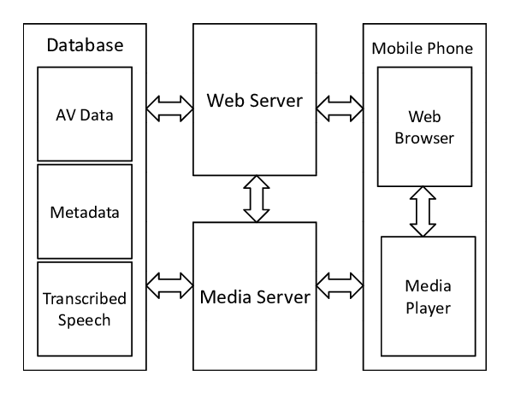
Components of a System
Systems consist of various components, including servers, databases, networks, and applications. Each of these components is susceptible to disasters, emphasizing the need for a comprehensive DRP that addresses the vulnerabilities in each area.
Fig:- System Components diagram

Slide 5





Common Types of Disasters
Natural Disasters (e.g., earthquakes, floods)
Human-Made Disasters (e.g., power outages, equipment failures)
Cyber-Attacks (e.g., malware, ransomware)
Fig:- Disasters types icons

Slide 6
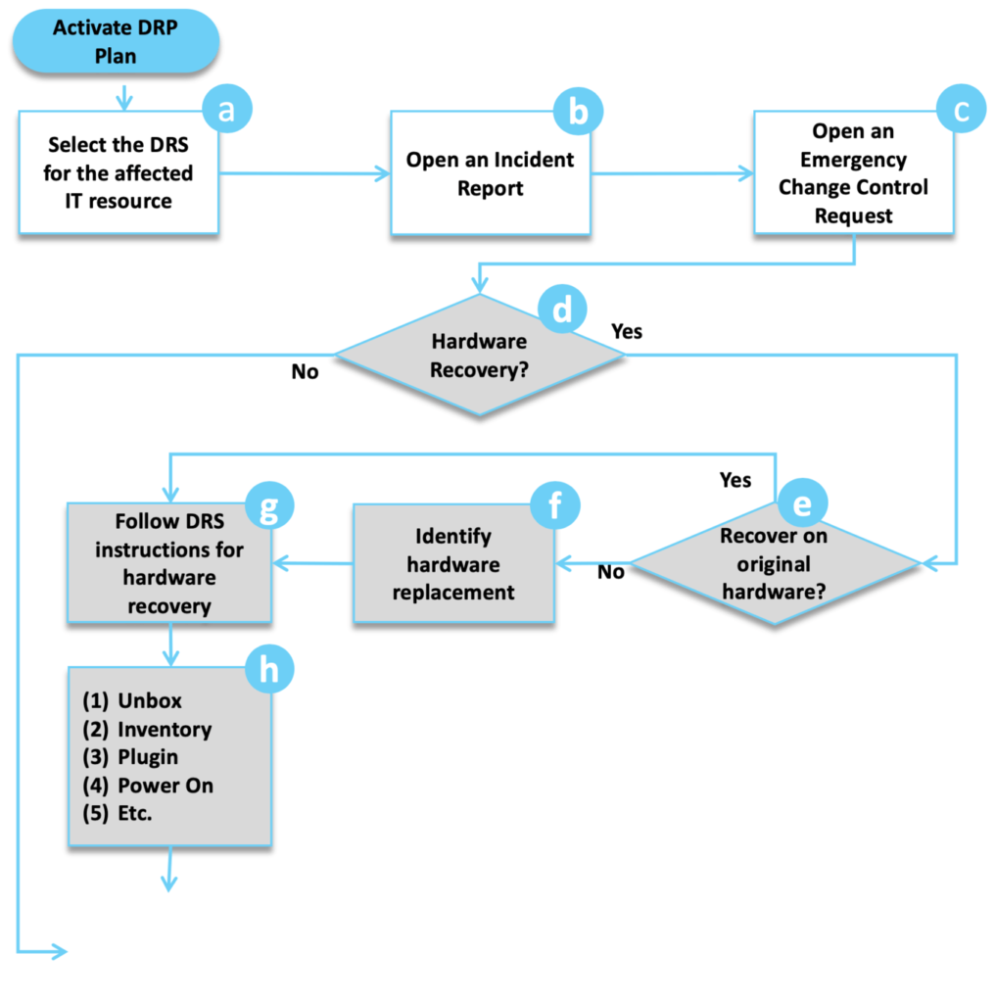
Key Steps in Disaster Recovery Planning
Business Impact Analysis
Risk Assessment
Developing the DRP
Testing and Training
Regular Updates
DRP Process Flowchart

Slide 7
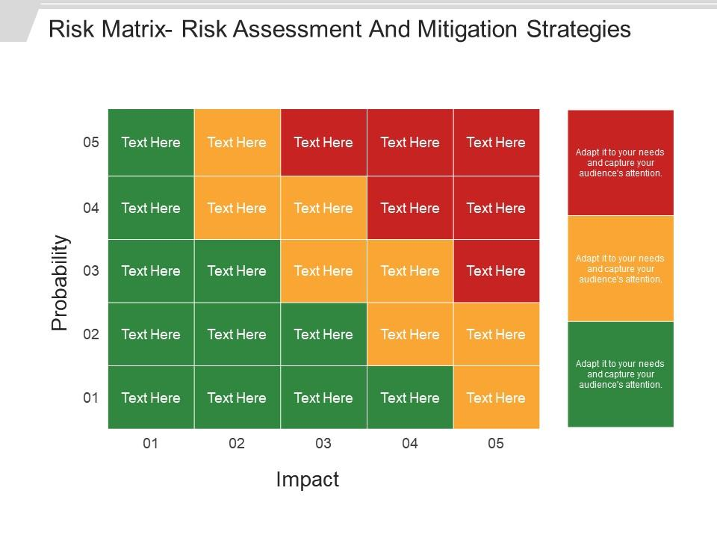
Risk Assessment and Mitigation
Risk assessment identifies potential threats to the system. Mitigation strategies, such as data backups, redundancy, and security measures, help in minimizing the impact of these risks.
Risk matrix

Slide 8
Testing and Updating the DRP
Regular testing of the DRP is essential to ensure its effectiveness. This process includes simulations, drills, and scenario-based exercises. Additionally, periodic updates to the plan are crucial to account for changes in technology, business processes, and potential new risks.

Slide 9
Thanks…!

